Slide 1

Smart Home
Using Arduino supported with web application

Slide 2



Tech Requirements
Sensors
Micro Controller
House Design

Slide 3



Stages
Gate
Fire & Gas Safety
Lighting
In
,
Alarm is included

Slide 4


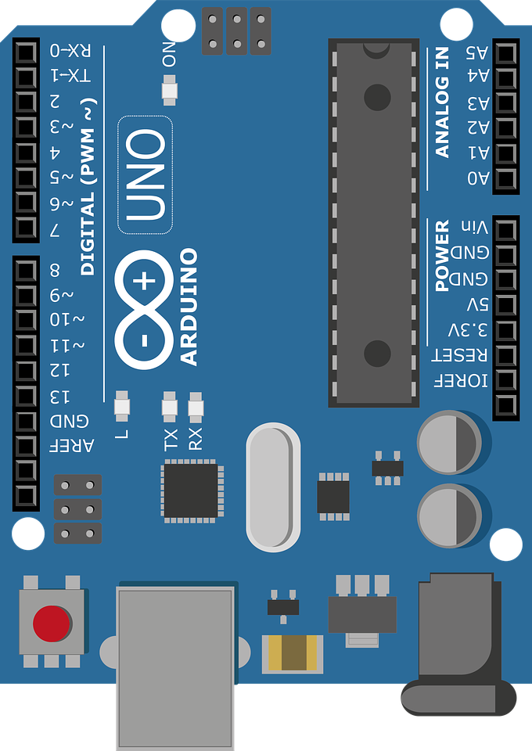
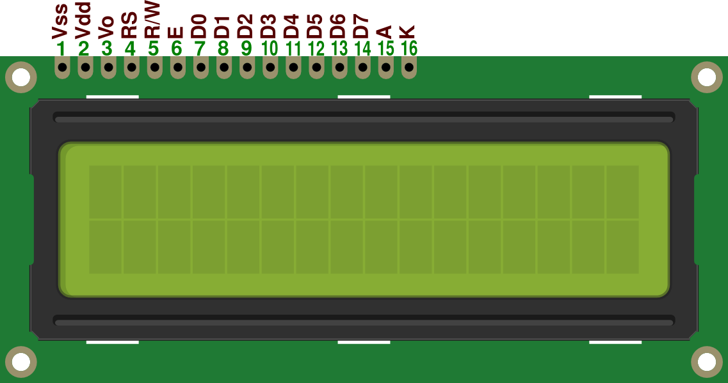



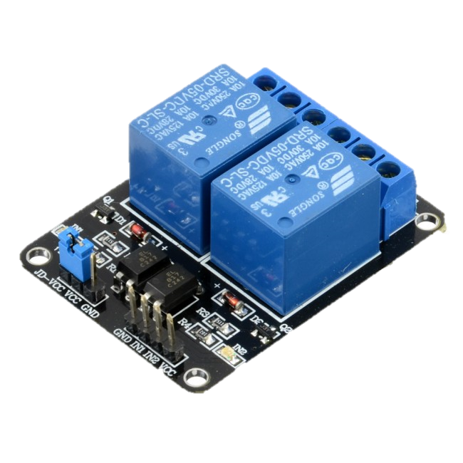
Gate
Components
Keypad
Arduino
LCD
Servo Motor
Buzzer
RGB LED
2 channel relay module

Slide 5

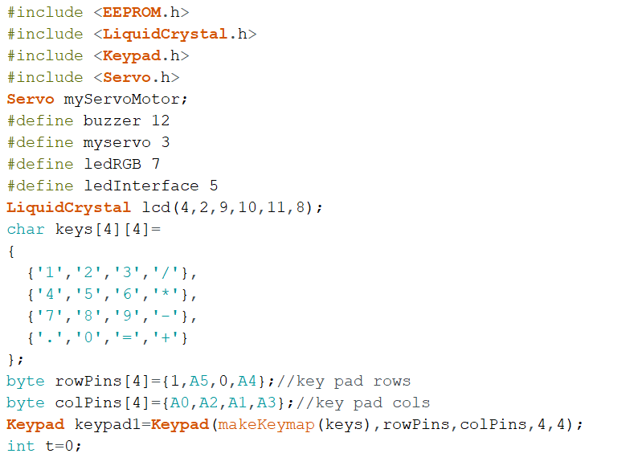
Gate
Code
Definitions, libraries & Object Creation

Slide 6
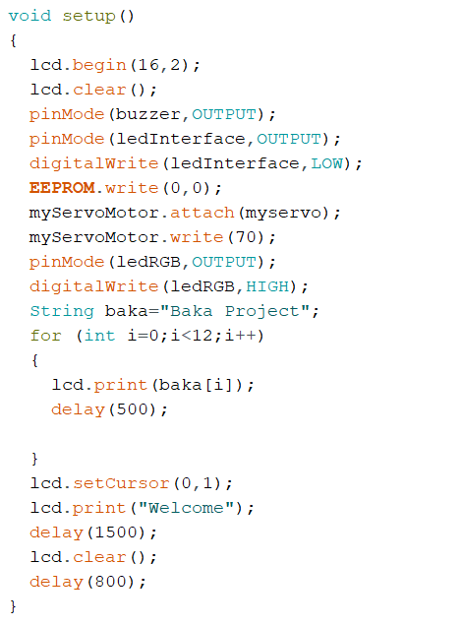
Gate
Code
Setup ( lcd, close gate & turn outer lights on )

Slide 7
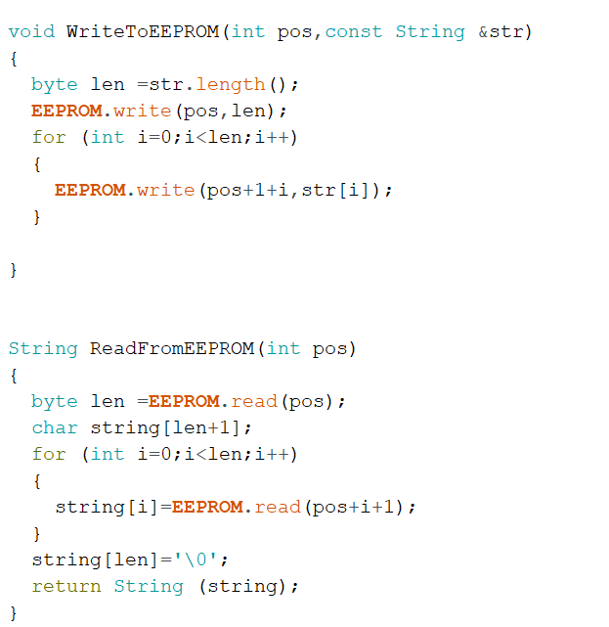
Gate
Code
Read & write to EeproM

Slide 8
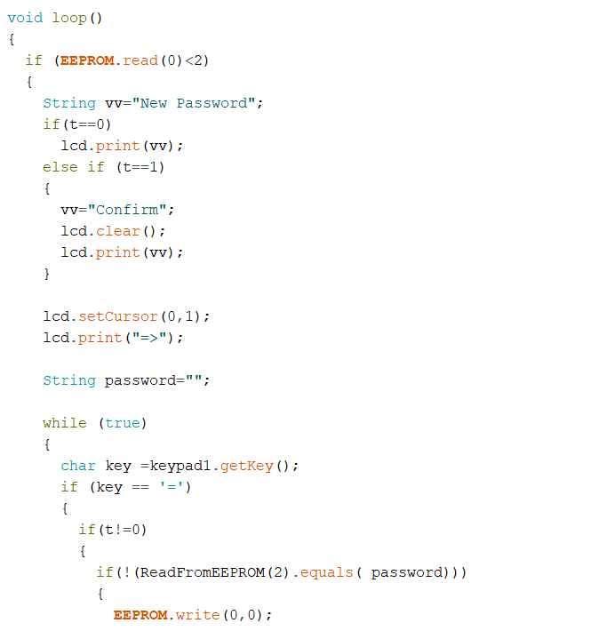
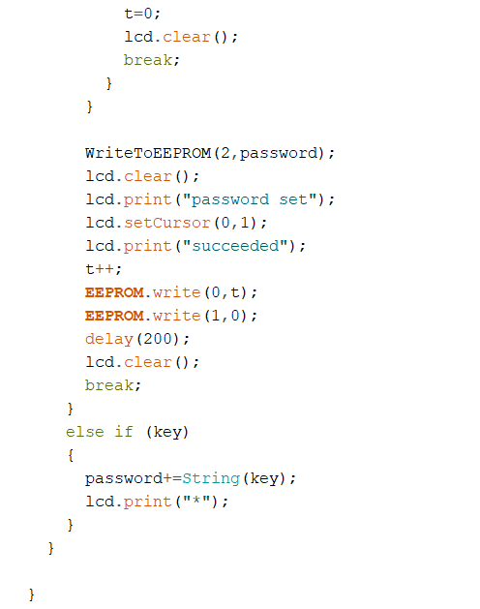
Gate
Code
Setting & Confirming password

Slide 9
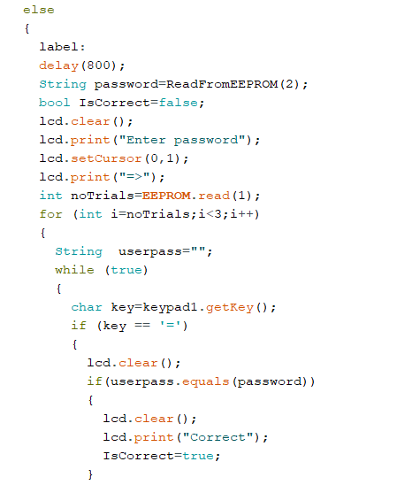
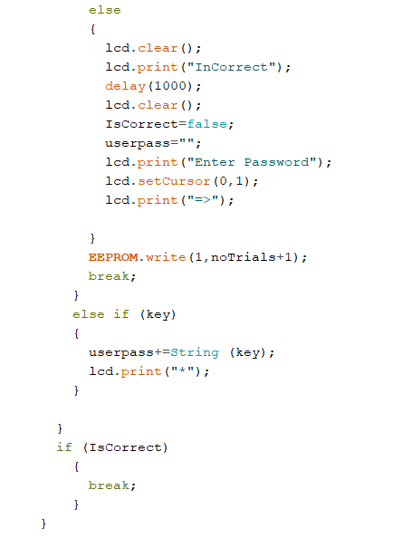
Gate
Code
Enter Password & Check

Slide 10
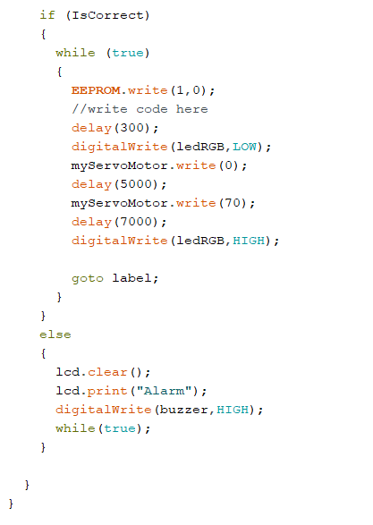
Gate
Code
open gate if correct
Turn alarm if not correct

Slide 11

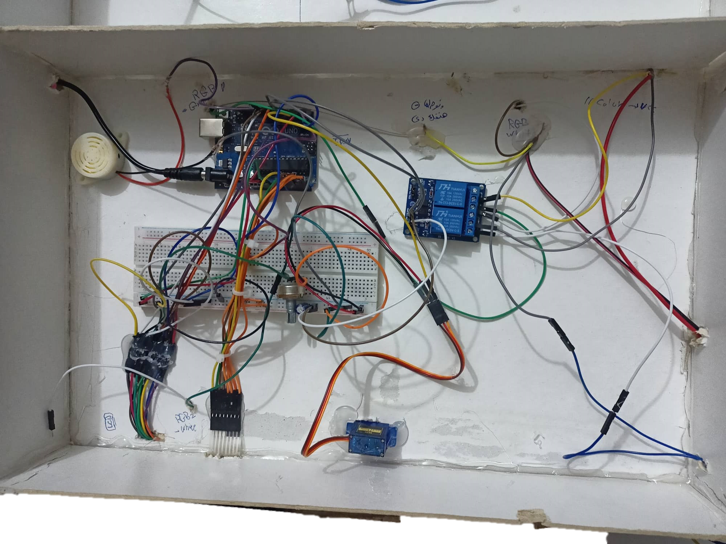
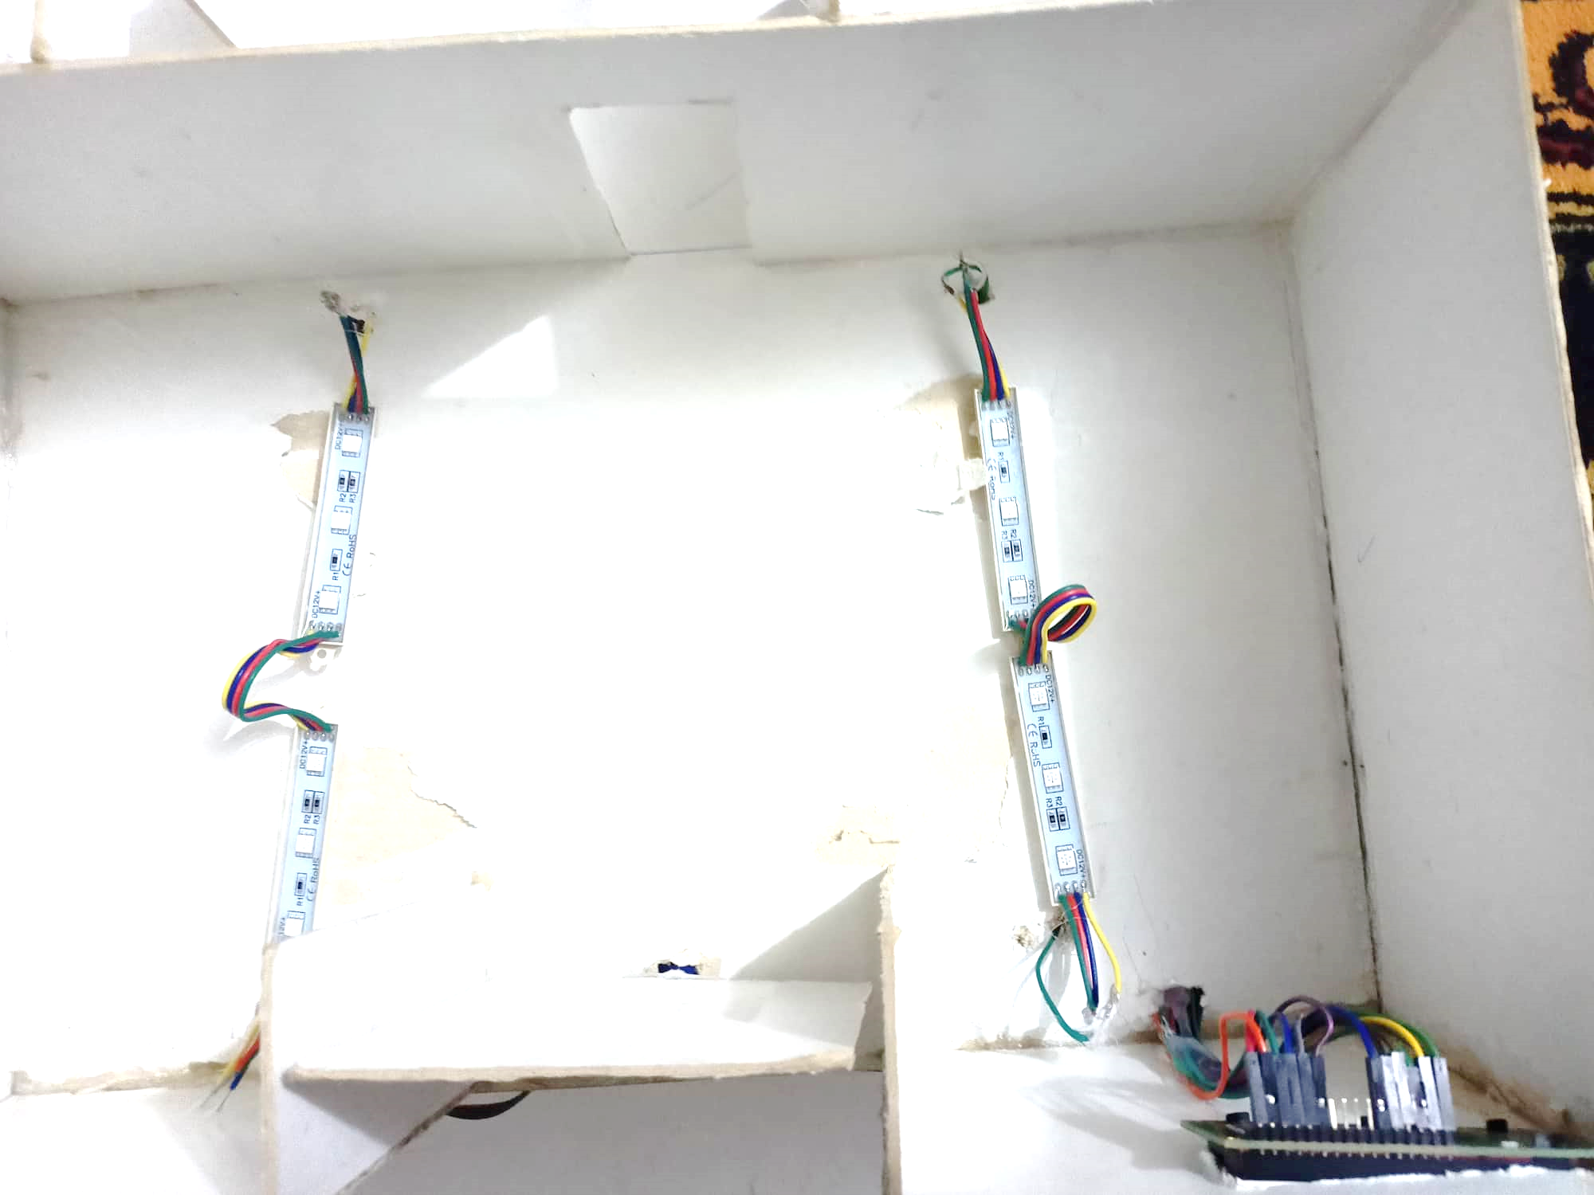
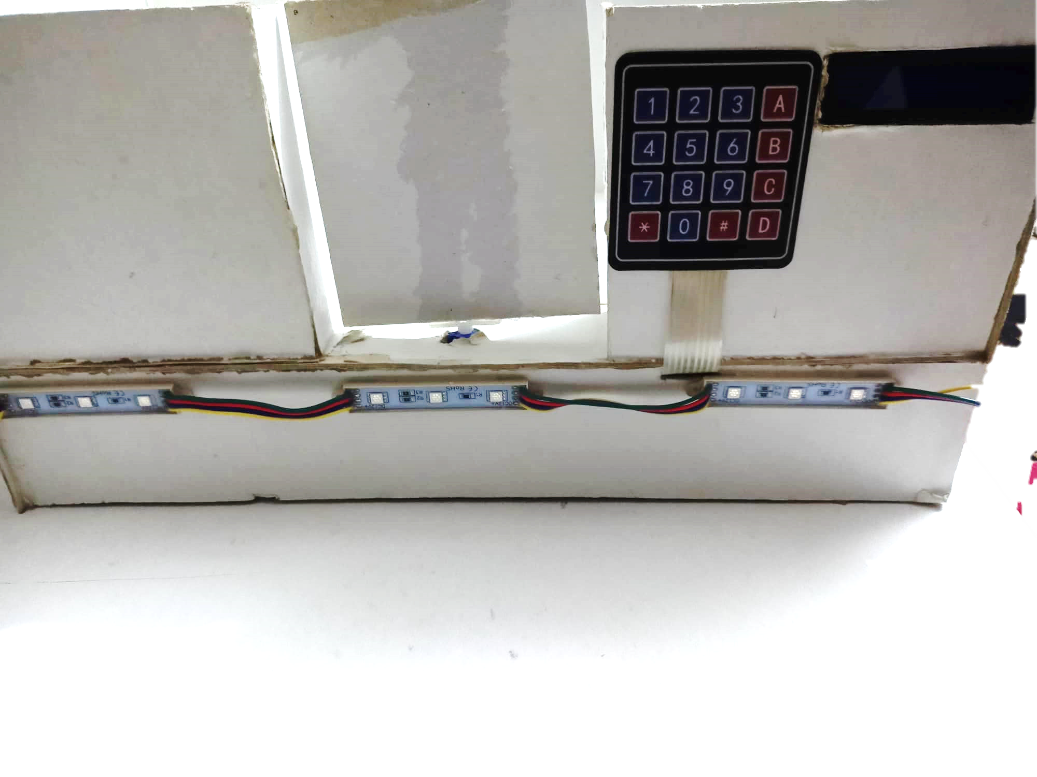


Gate
Hardware
Backend
Frontend

Slide 12

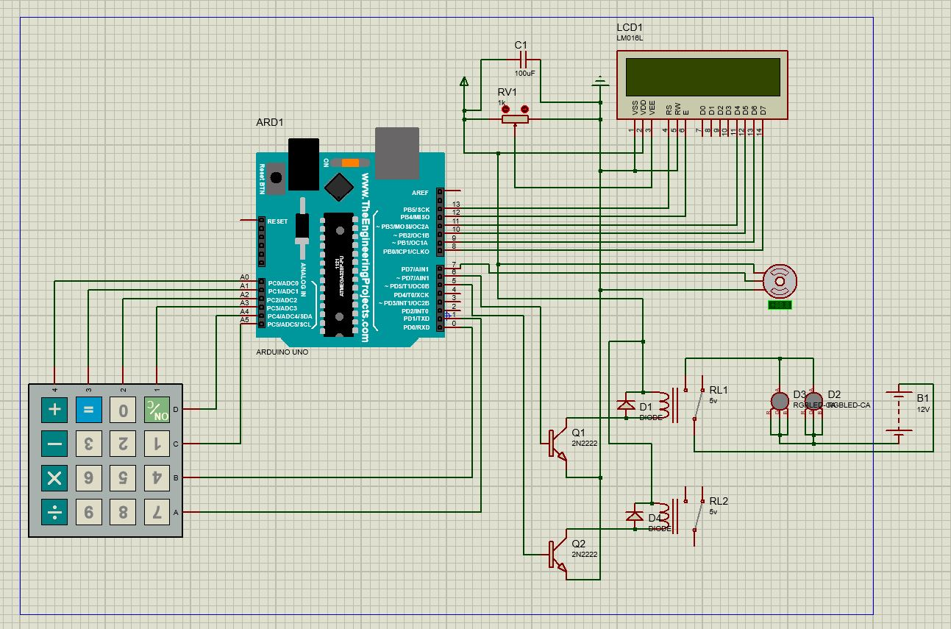
Gate
Schematic

Slide 13

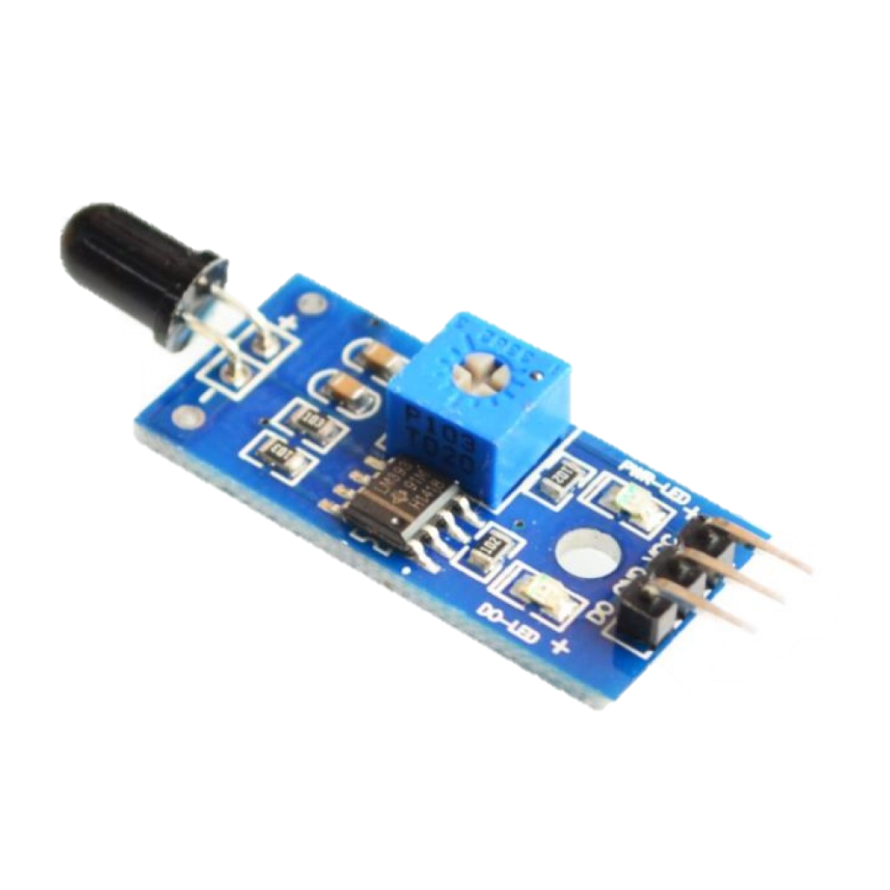
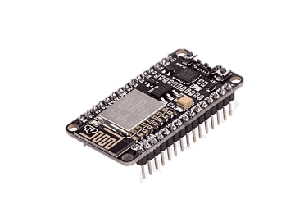
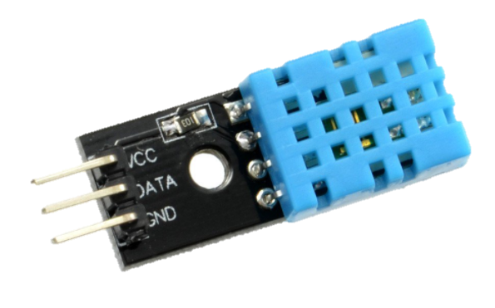
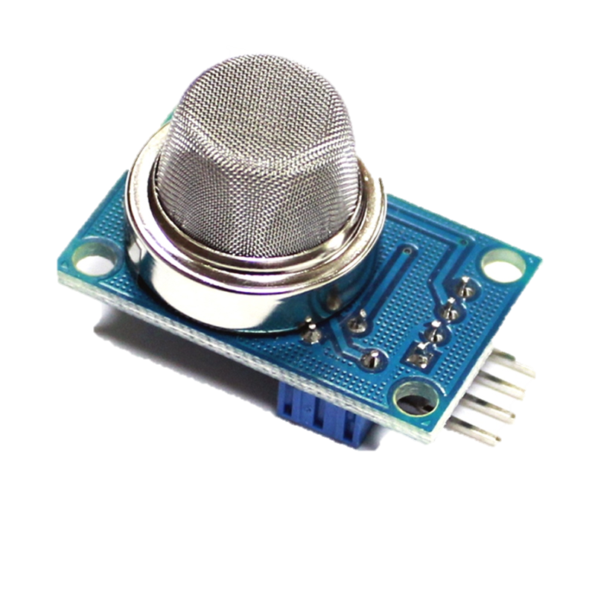
Fire and safety
Components
Flame sensor
NodeMcu
Buzzer
DHT 11 Sensor
Mq2 Sensor

Slide 14

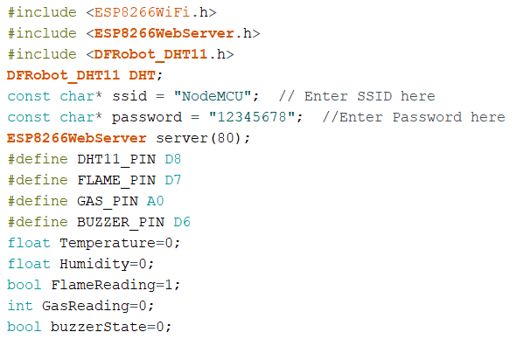
Fire and safety
Code
Definitions, libraries & Object Creation

Slide 15
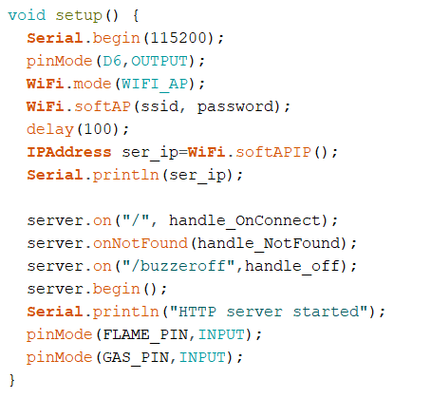
Fire and safety
Code
Setup ( Set access point & set sensors pins)

Slide 16
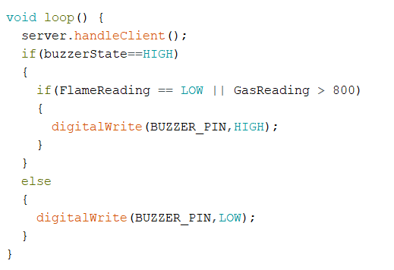
Fire and safety
Code
LOop ( implement function & turn buzzer on or ofF)

Slide 17
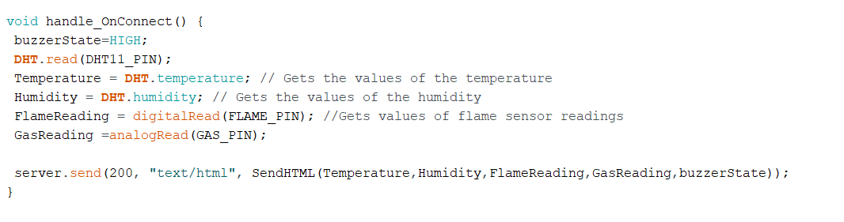
Fire and safety
Code
Default behaviour on starting server

Slide 18
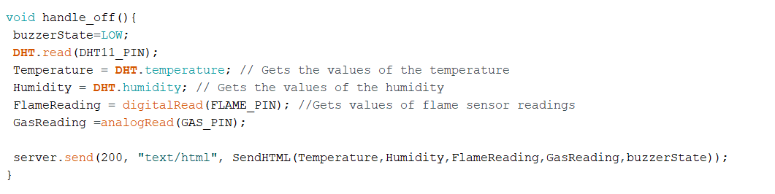
Fire and safety
Code
Behaviour when buzzer state is off

Slide 19
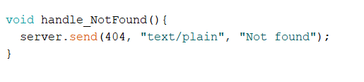
Fire and safety
Code
Behaviour when request fails

Slide 20
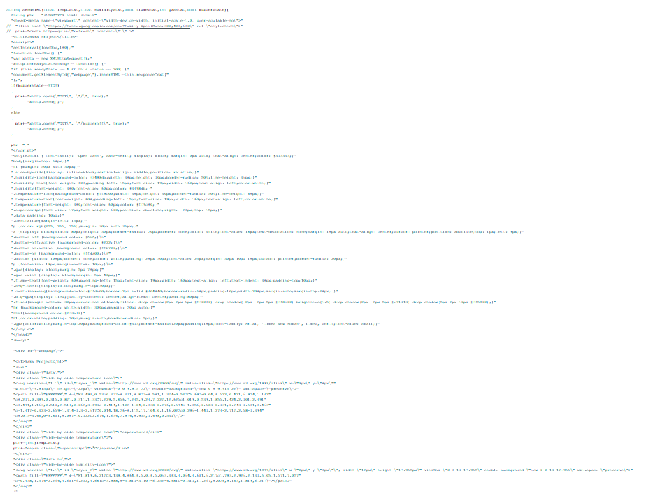
Fire and safety
Code
HTML Code
As a return from function

Slide 21
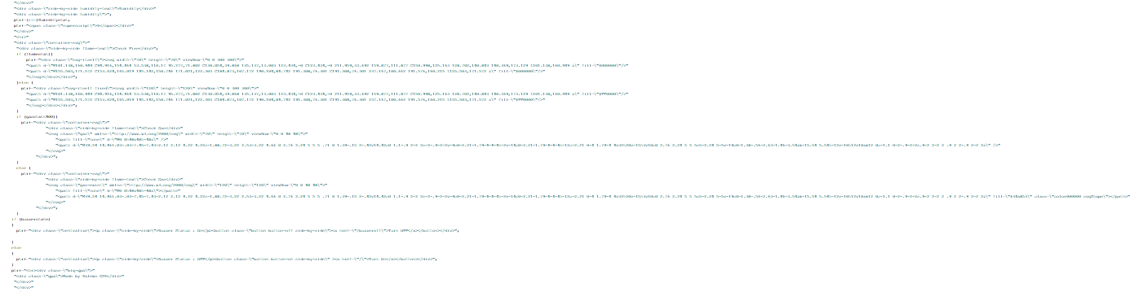
Fire and safety
Code
HTML Code
Continued

Slide 22
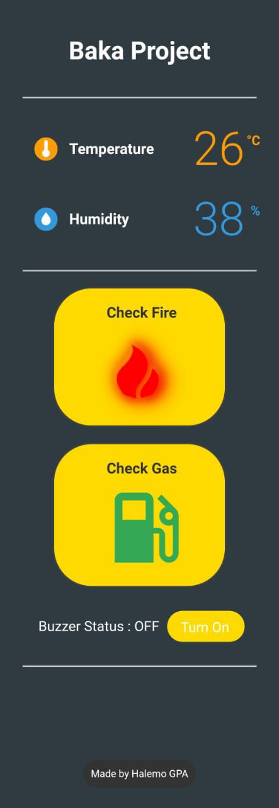
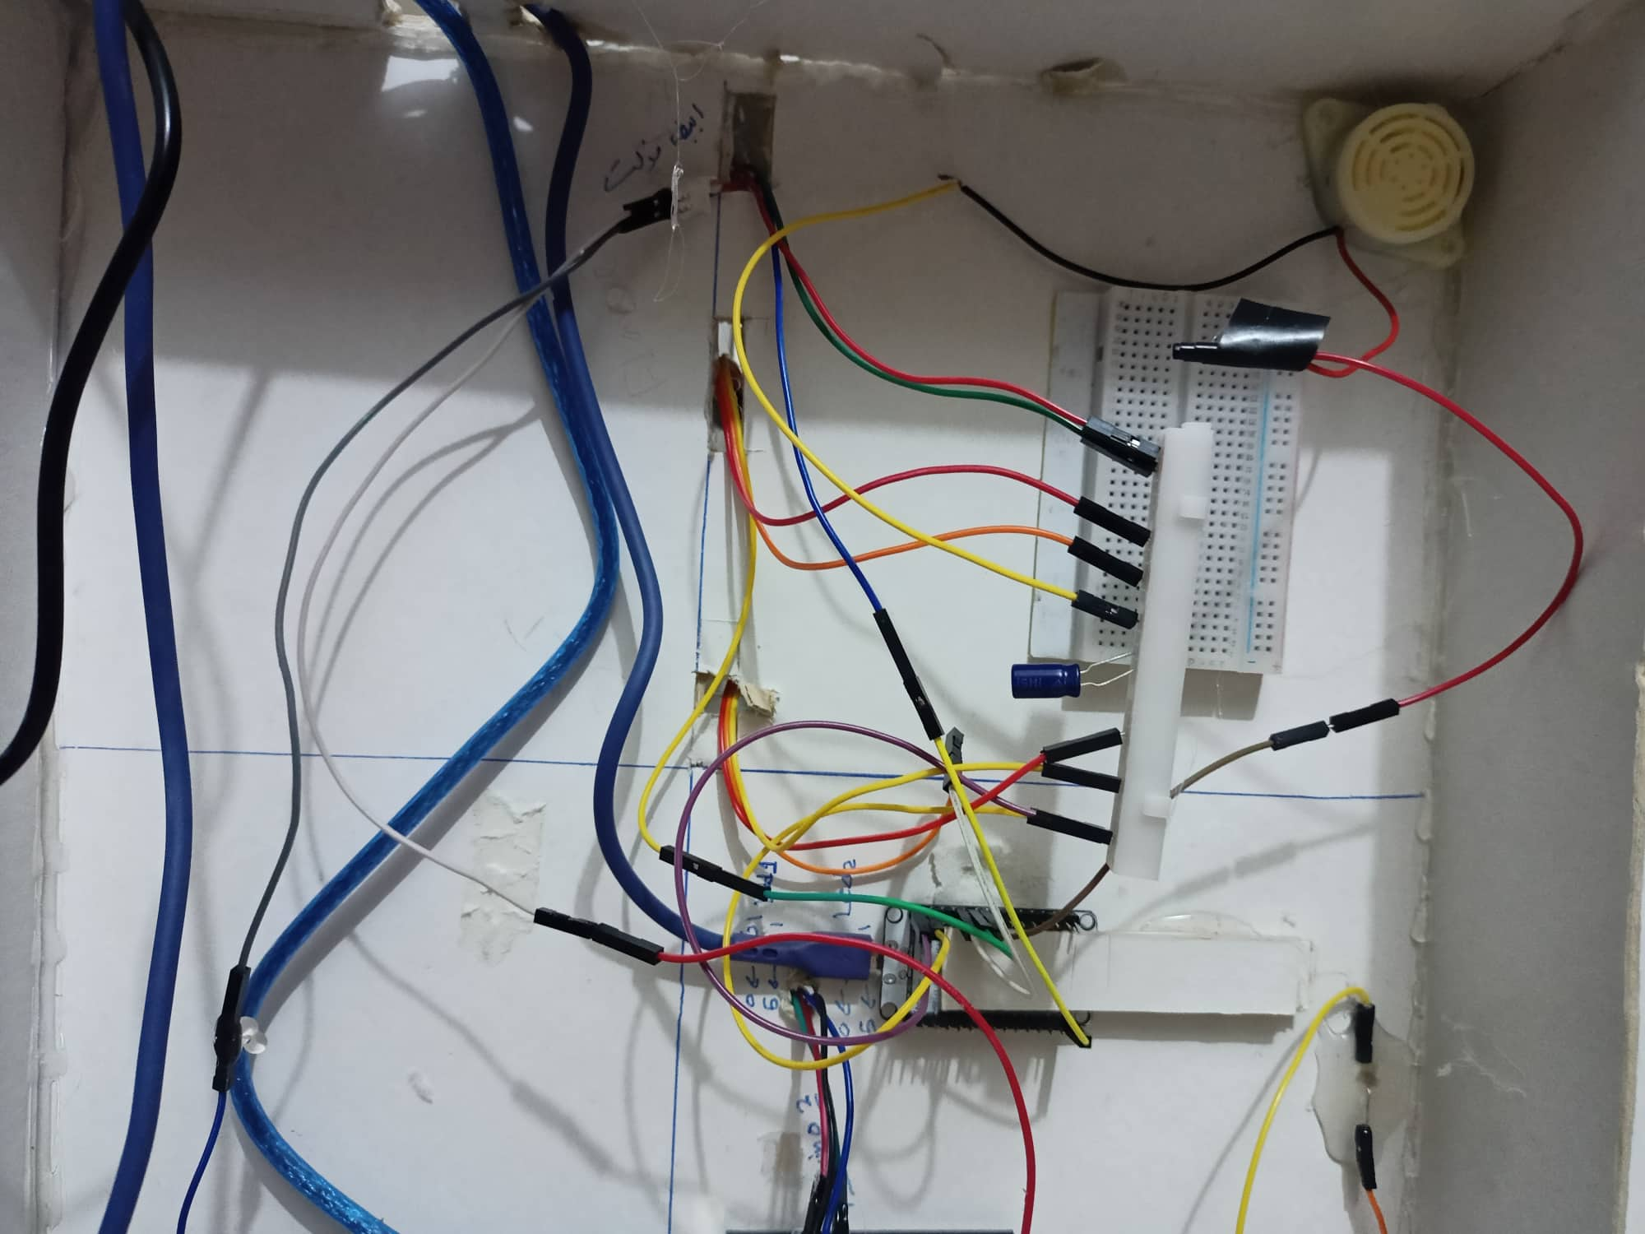
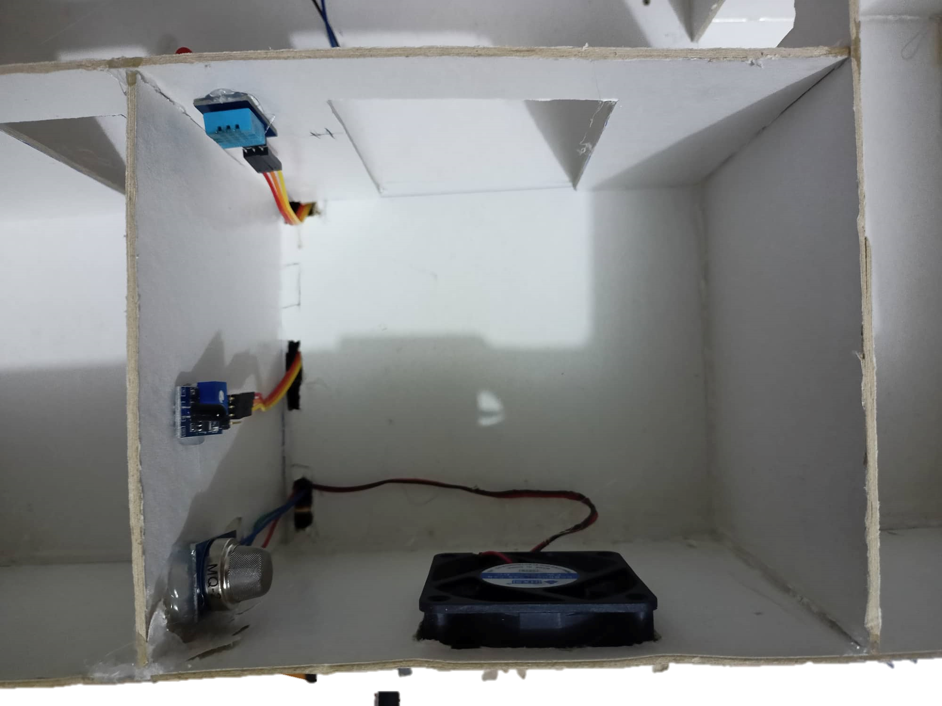
Fire and safety
Hardware
Backend
Frontend

Slide 23
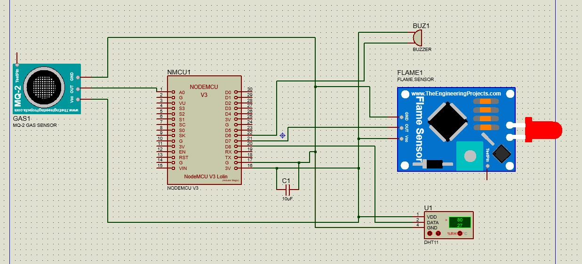
Fire and safety
Schematic

Slide 24




Lighting
Components
LDR Sensor
Arduino
LEDS
Fan

Slide 25

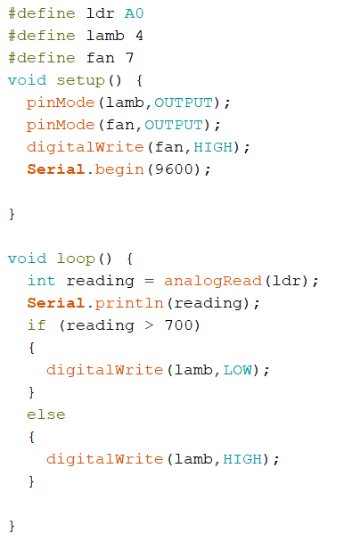
Lighting
Code
Turn on fan check lighting

Slide 26
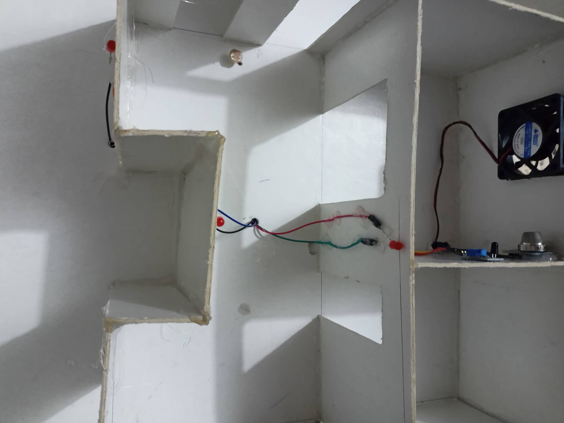
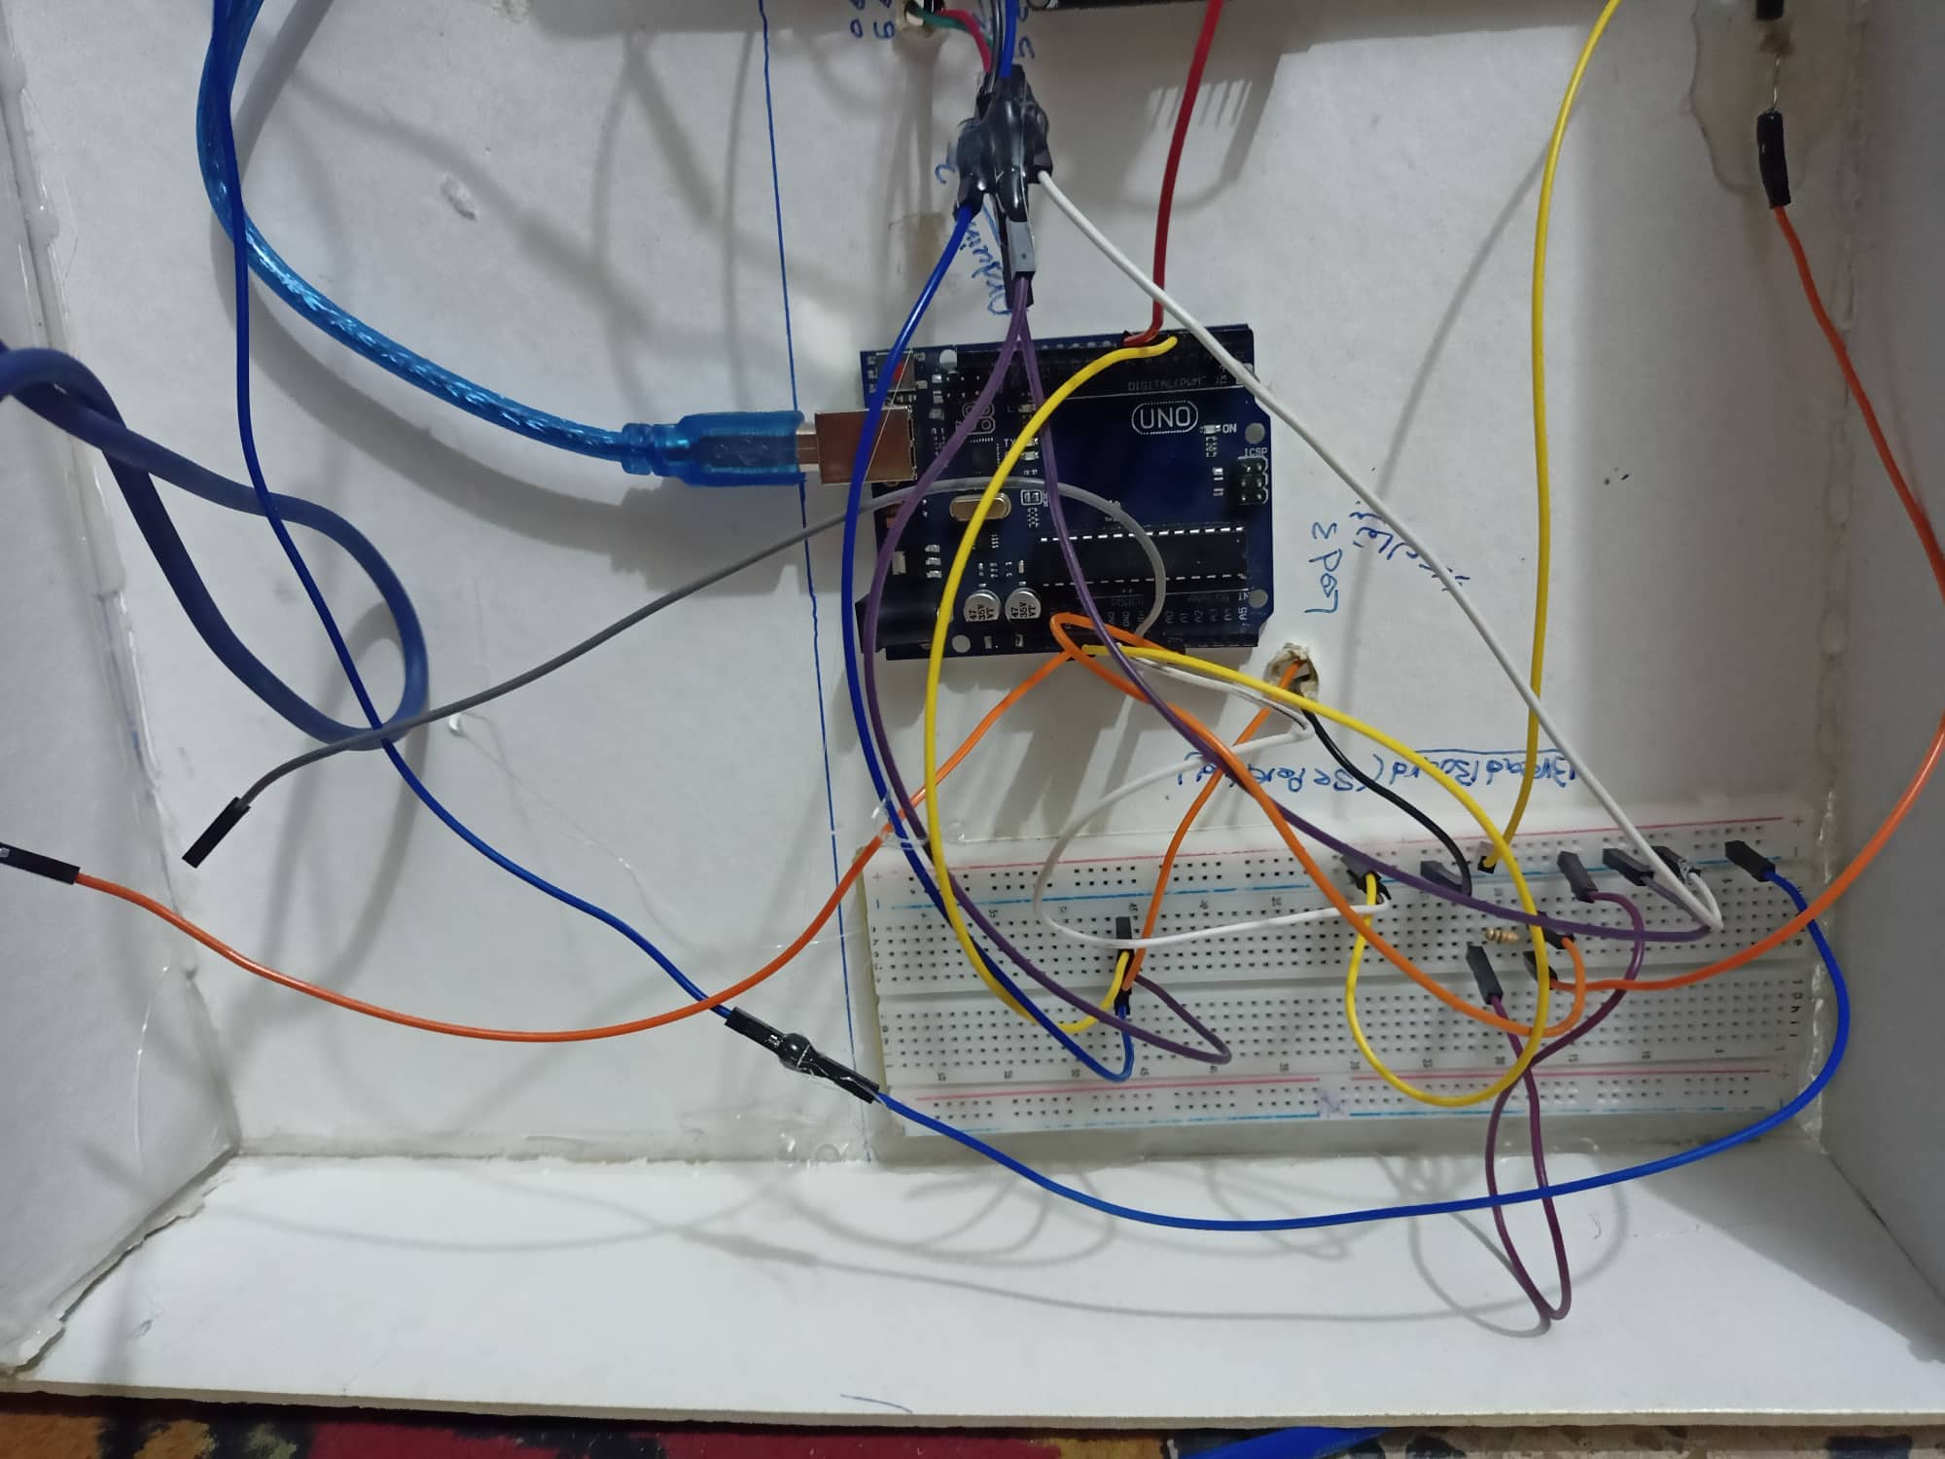
Lighting
Hardware
Backend
Frontend

Slide 27
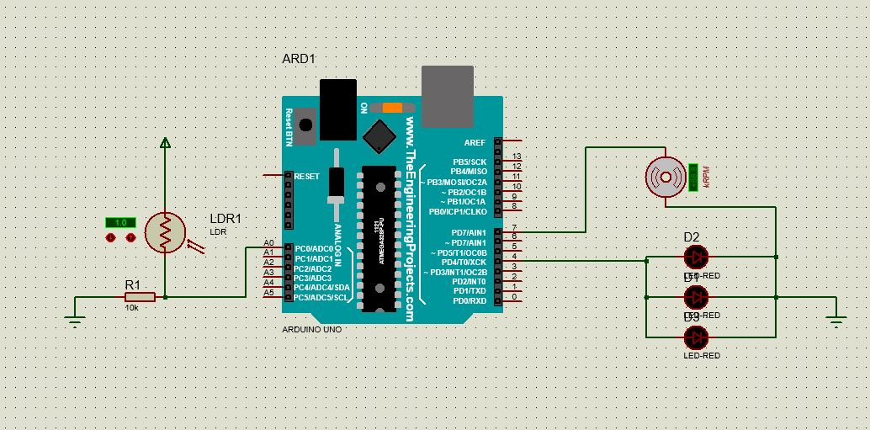
Lighting
Schematic

Slide 28
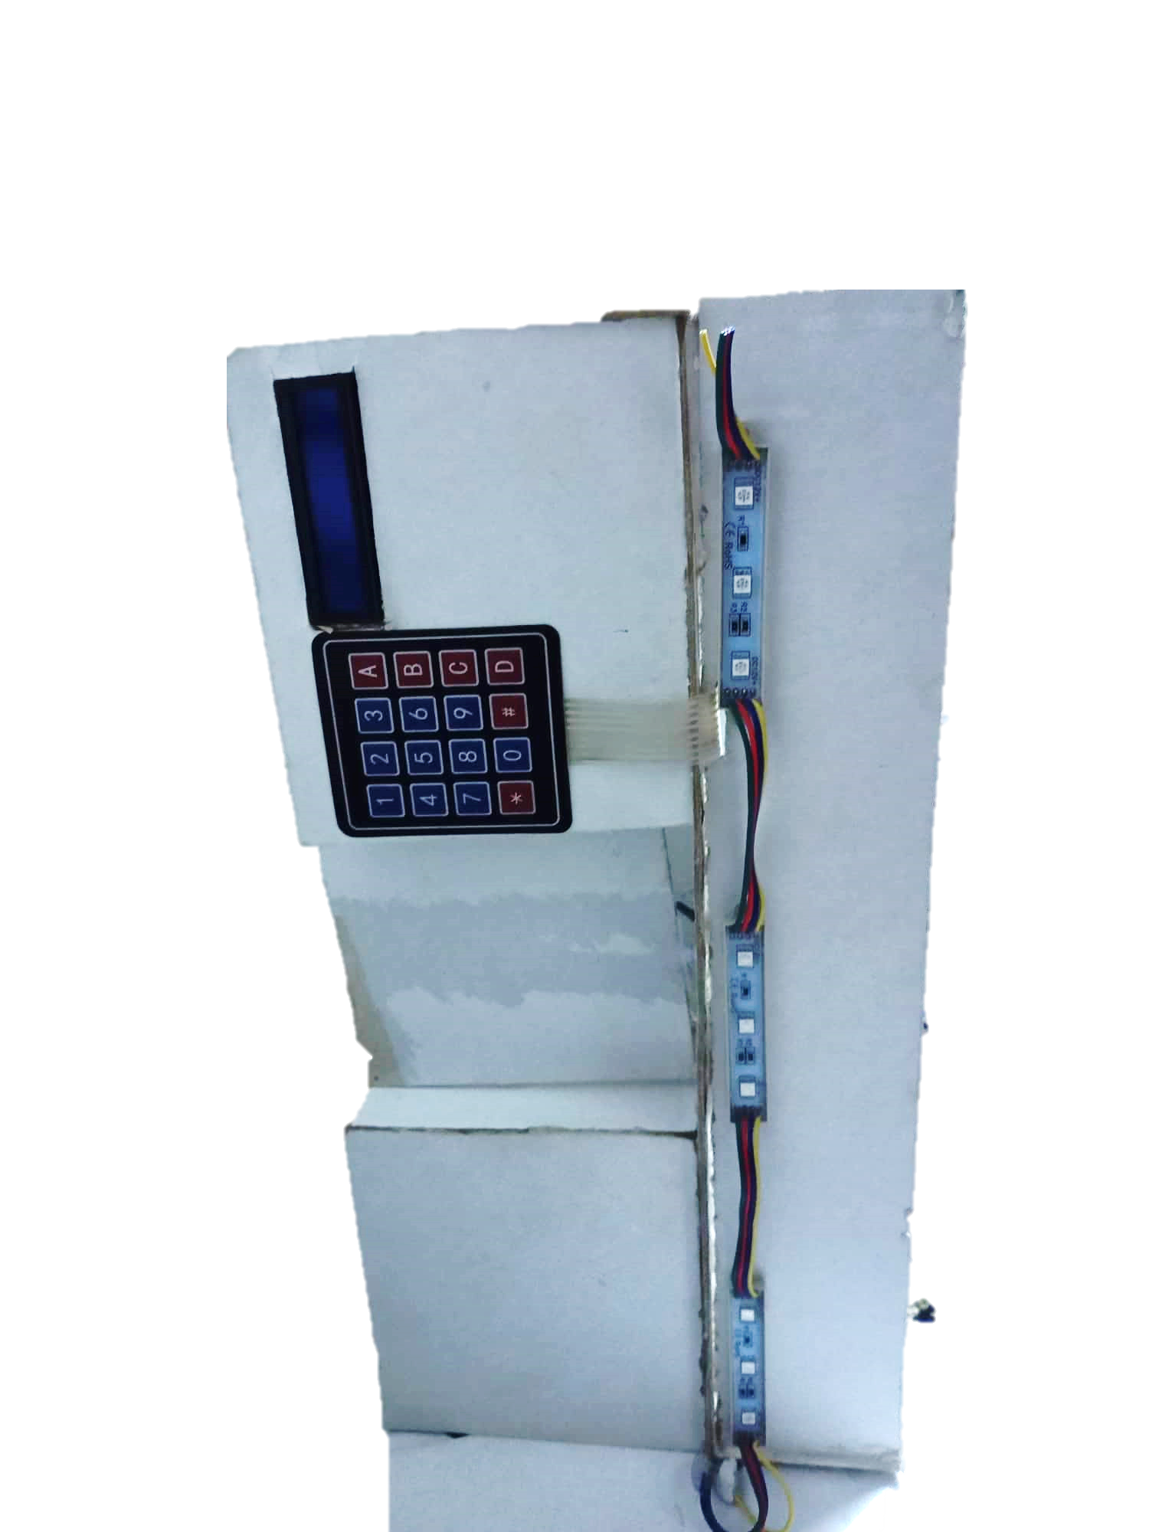
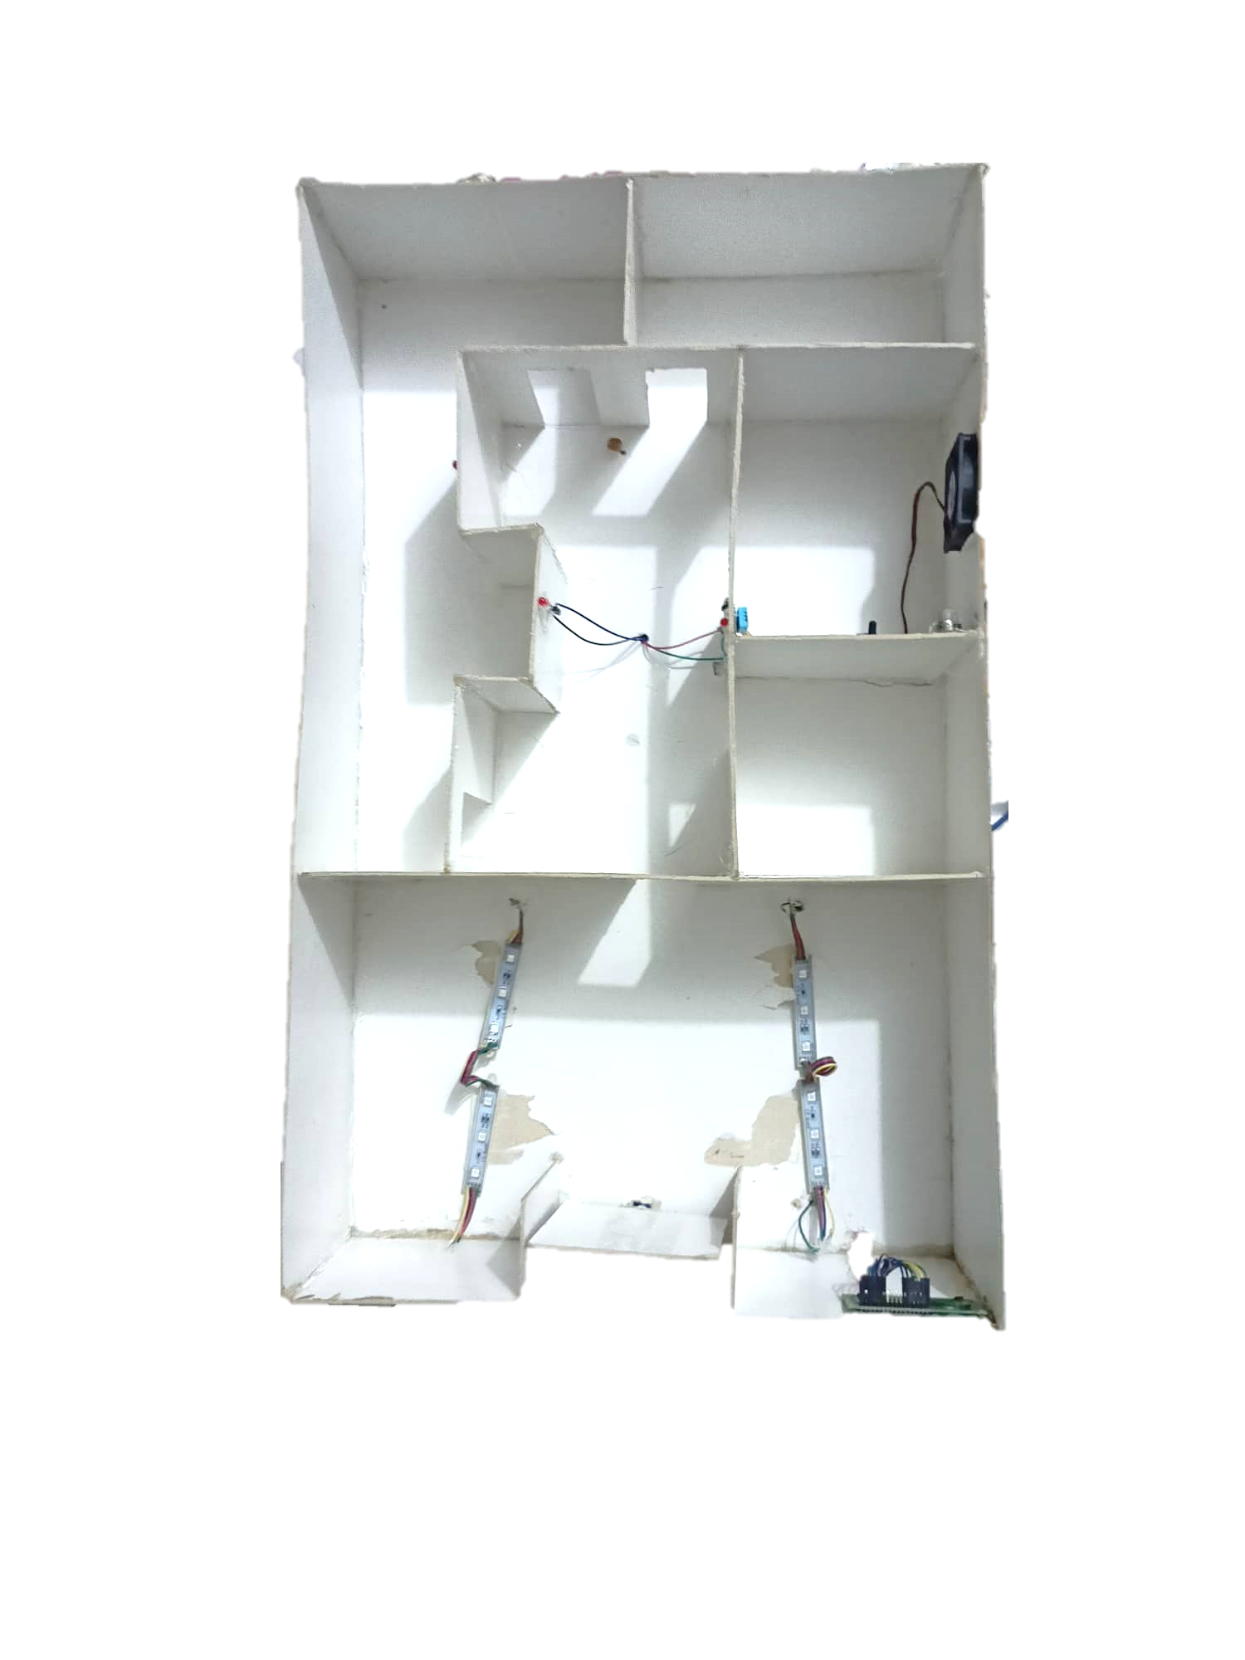
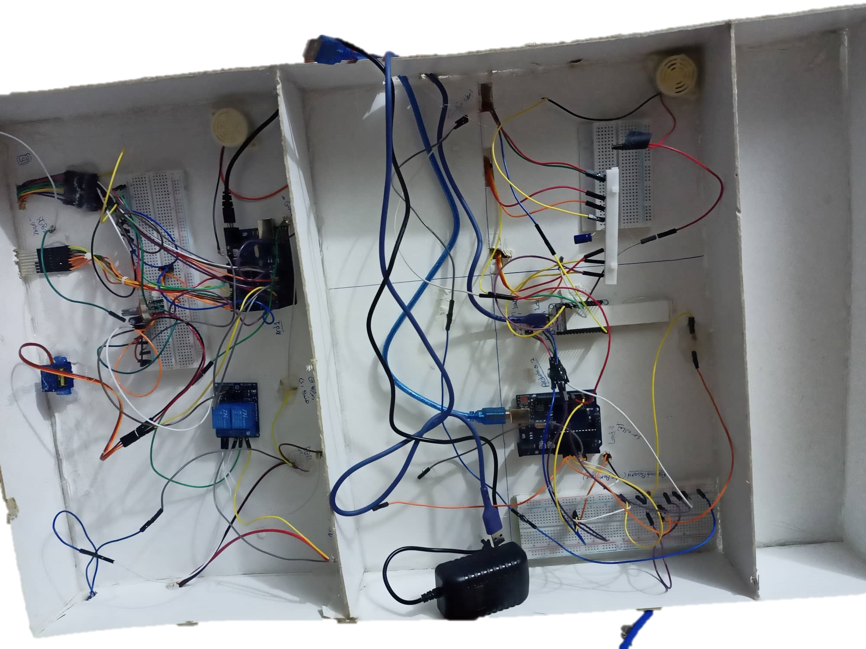
The Whole Project
FRONT
Top
Bottom

Slide 29

Thank You
This presentation
was made by
HalemoGPA

